Slide 1
Data Structures And Algorithms

Slide 2
Hashing
A technique to convert a range of key values into a range of indexes of an array
When it comes to data structures, hashing is a technique used to store and retrieve data in a database
Hashing is an efficient way to store and retrieve data in O(1), because it avoids the need for comparisons between elements
It also allows duplicate values to be stored in the same structure without causing collisions
It is also called the mapping technique as larger values are mapped into smaller ones
There are many different hashing algorithms, but they all share the same basic principle

Slide 3
Basic terminologies
Search Keys
Hash Tables
Hash Functions

Slide 4
Hash tables
The hash table is an associative data structure that stores data as associated keys
An array format is used to store hash table data, where each value is assigned its unique index
By knowing the index of the desired data, we can access it very quickly
As a result, inserting and searching data is very fast, regardless of data size
In a Hash Table, elements are stored in an array, and an index is generated using hashing techniques in a data structure

Slide 5
Hash tables
Hash table is basically an array
However, in hash table whenever data is inserted, deleted or searched it does not require scanning the whole data
Hash table insert, delete and search a value with the help of hash function
The Hash table data structure stores elements in key-value pairs where
Key- unique integer that is used for indexing the values
Value - data that are associated with keys.

Slide 6
Hash Function
Several hash functions are described in the literature. Here we describe some of the commonly used hash functions:
Mid-Square: In this method, the hash function, h, is computed by squaring the identifier, and then using the appropriate number of bits from the middle of the square to obtain the bucket address. Because the middle bits of a square usually depend on all the characters, it is expected that different keys will yield different hash addresses with high probability, even if some of the characters are the same.
Folding: In folding, the key X is partitioned into parts such that all the parts, except possibly the last parts, are of equal length. The parts are then added, in some convenient way, to obtain the hash address.
Division (Modular arithmetic): In this method, the key X is converted into an integer. This integer is then divided by the size of the hash table to get the remainder, giving the address of X in HT.

Slide 7

Hash function
Value to be inserted:
8, 2,10, 0, 11,
Calculate Hash Function/ hash value
$h\left(x\right)=x$
0 | 1 | 2 | 3 | 4 | 5 | 6 | 7 | 8 | 9 | 10 | 11 | 12 | 13
0 |  | 2 |  |  |  |  |  | 8 |  | 10 | 11

Slide 8

Hash function
Value to be inserted:
8, 2,10, 0, 11, 25
Calculate Hash Function/ hash value
$h\left(x\right)=x$
0 | 1 | 2 | 3 | 4 | 5 | 6 | 7 | 8 | 9 | 10 | 11 | 12 | 13
0 |  | 2 |  |  |  |  |  | 8 |  | 10 | 11

Slide 9

Hash function (Division Method)
Value to be inserted:
24, 52, 91, 67, 48, 83
Calculate Hash Function/ hash value
$h\left(x\right)=x \% size of table$
0 | 1 | 2 | 3 | 4 | 5 | 6 | 7 | 8 | 9
 | 91 | 52 | 83 | 24 |  |  | 67 | 48

Slide 10

Hash function (Division Method)
Value to be inserted:
8, 66, 9, 57, 20,
Calculate Hash Function/ hash value
$h\left(x\right)=x \% size of table$
0 | 1 | 2 | 3 | 4 | 5 | 6 | 7 | 8 | 9
20 |  |  |  |  |  | 66 | 57 | 8 | 9

Slide 11

Hash function (Division Method)
Value to be inserted:
8, 66, 9, 57, 20, 43, 76
Calculate Hash Function/ hash value
$h\left(x\right)=x \% size of table$
0 | 1 | 2 | 3 | 4 | 5 | 6 | 7 | 8 | 9
20 |  |  | 3 |  |  | 66 | 57 | 8 | 9
This is called collision
There is already some data at index 6

Slide 12
collision
A hash function gets us a small number for a key which is a big integer or string
There is a possibility that two keys result in the same value
The situation where a newly inserted key maps to an already occupied slot in the hash table is called collision
It must be handled using some collision handling technique

Slide 13
Collision Resolution techniques
Open Hashing/ Closed Addressing
Separate Chaining
Closed Hashing/ Open Addressing
Linear Probing
Quadratic Probing
Double Hashing

Slide 14
Separate chaining
The idea behind separate chaining is to implement the array as a linked list called a chain
Separate chaining is one of the most popular and commonly used techniques in order to handle collisions
So what happens is, when multiple elements are hashed into the same slot index, then these elements are inserted into a singly-linked list which is known as a chain

Slide 15
Separate chaining
Let us consider a simple hash function as “key mod 7” and a sequence of keys as 50, 700, 76, 85, 92, 73, 101

Slide 16
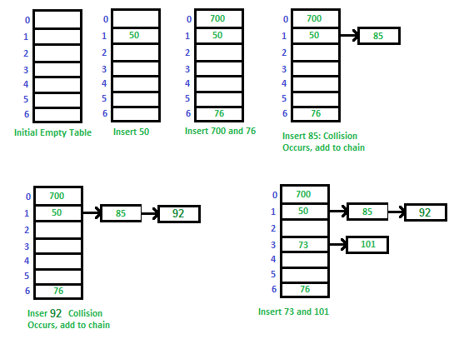
Separate chaining

Slide 17
Separate chaining
Advantages
Disadvantages
Simple to implement.
Hash table never fills up, we can always add more elements to the chain.
Less sensitive to the hash function or load factors.
It is mostly used when it is unknown how many and how frequently keys may be inserted or deleted.
The cache performance of chaining is not good as keys are stored using a linked list.
Wastage of Space (Some Parts of the hash table are never used)
If the chain becomes long, then search time can become O(n) in the worst case
Uses extra space for links

Slide 18
Open addressing/ Closed hashing
Linear Probing
Quadratic Probing
Double Hashing

Slide 19
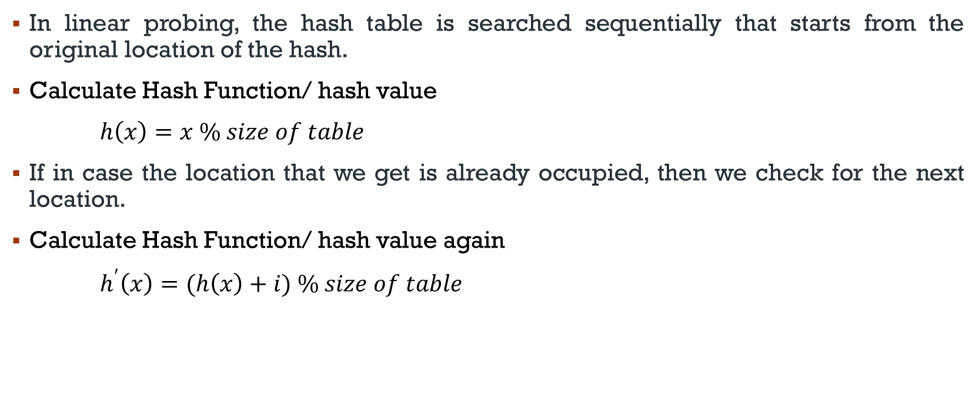
Linear probing
In linear probing, the hash table is searched sequentially that starts from the original location of the hash.
Calculate Hash Function/ hash value
$h\left(x\right)=x \% size of table$
If in case the location that we get is already occupied, then we check for the next location.
Calculate Hash Function/ hash value again
$h^{′}\left(x\right)=(h\left(x\right)+i) \% size of table$

Slide 20
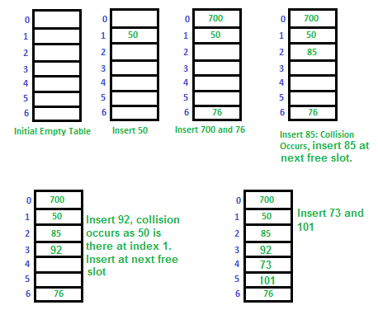
Linear probing

Slide 21
Linear probing
Advantages
Disadvantages
Overall, linear probing is a simple and efficient method for handling collisions in hash tables
It can be used in a variety of applications that require efficient storage and retrieval of data
No extra space is wasted
Searching time is O(n)
Two main challenges for linear probing are:
Primary Clustering: One of the problems with linear probing is Primary clustering, many consecutive elements form groups and it starts taking time to find a free slot or to search for an element.
Secondary Clustering: Secondary clustering is less severe, two records only have the same collision chain (Probe Sequence) if their initial position is the same.

Slide 22
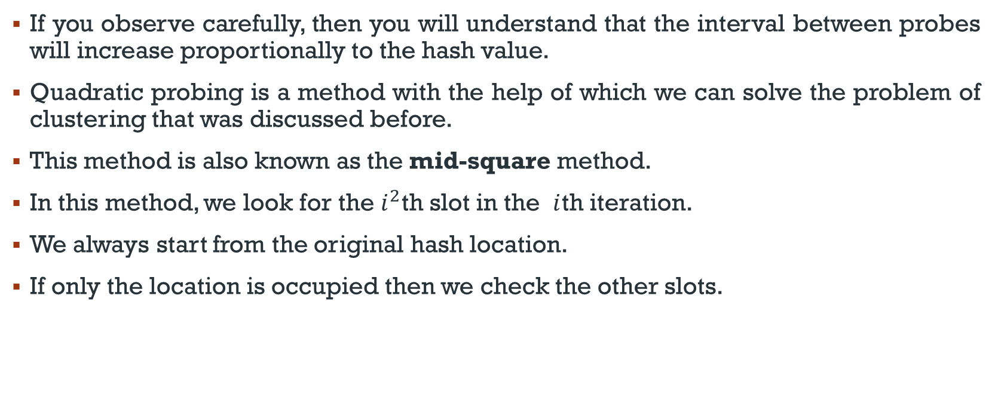
Quadratic probing
If you observe carefully, then you will understand that the interval between probes will increase proportionally to the hash value.
Quadratic probing is a method with the help of which we can solve the problem of clustering that was discussed before.
This method is also known as the mid-square method.
In this method, we look for the $i^{2}$th slot in the $i$th iteration.
We always start from the original hash location.
If only the location is occupied then we check the other slots.

Slide 23
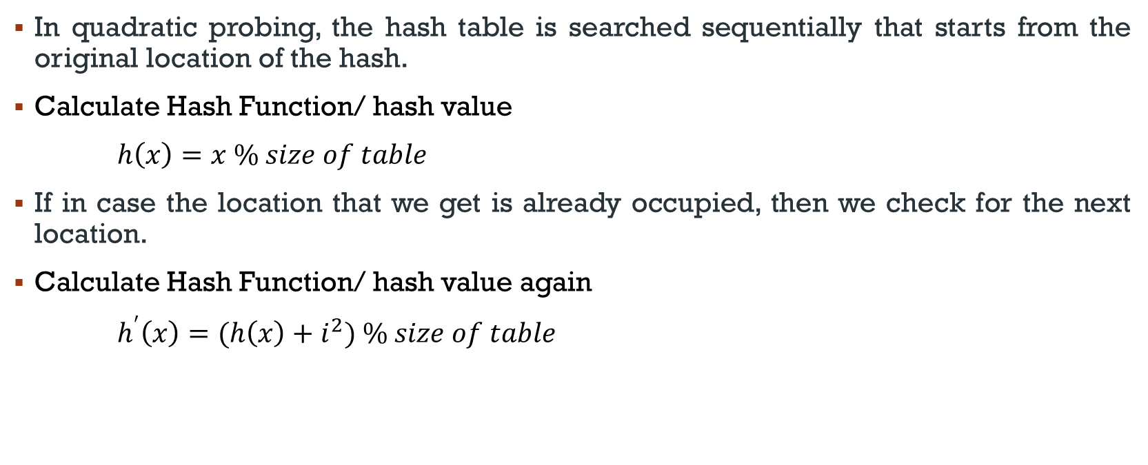
quadratic probing
In quadratic probing, the hash table is searched sequentially that starts from the original location of the hash.
Calculate Hash Function/ hash value
$h\left(x\right)=x \% size of table$
If in case the location that we get is already occupied, then we check for the next location.
Calculate Hash Function/ hash value again
$h^{′}\left(x\right)=(h\left(x\right)+i^{2}) \% size of table$

Slide 24
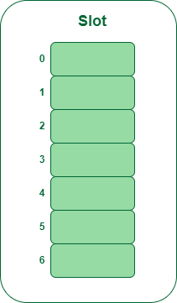
Quadratic probing
Let us consider table Size = 7, hash function as Hash(x) = x % 7
Collision resolution strategy to be f(i) = i² . Insert = 22, 30, and 50.
Step 1: Create a table of size 7.

Slide 25
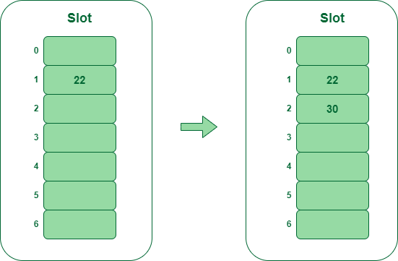
Quadratic probing
Hash(22) = 22 % 7 = 1, Since the cell at index 1 is empty, we can easily insert 22 at slot 1.
Hash(30) = 30 % 7 = 2, Since the cell at index 2 is empty, we can easily insert 30 at slot 2.

Slide 26
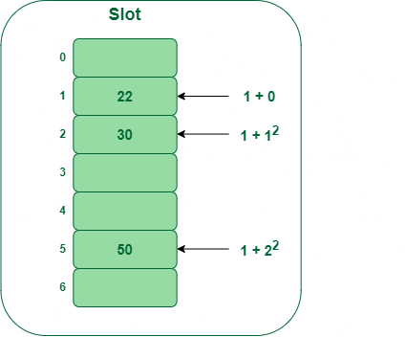
Quadratic probing
Hash(50) = 50 % 7 = 1
In our hash table slot 1 is already occupied. So, we will search for slot 1+1², i.e. 1+1 = 2,
Again slot 2 is found occupied, so we will search for cell 1+2², i.e.1+4 = 5,
Now, cell 5 is not occupied so we will place 50 in slot 5.

Slide 27
Quadratic probing
Advantages
Disadvantages
No extra space is wasted
Primary clustering issue is resolved
Secondary clustering issue
Search time is O(n)
No guarantee of finding any slot

Slide 28
Double hashing
The intervals that lie between probes are computed by another hash function.
Double hashing is a technique that reduces clustering in an optimized way.
In this technique, the increments for the probing sequence are computed by using another hash function.
We use another hash function hash2(x) and look for the i*hash2(x) slot in the i^{th} rotation.

Slide 29
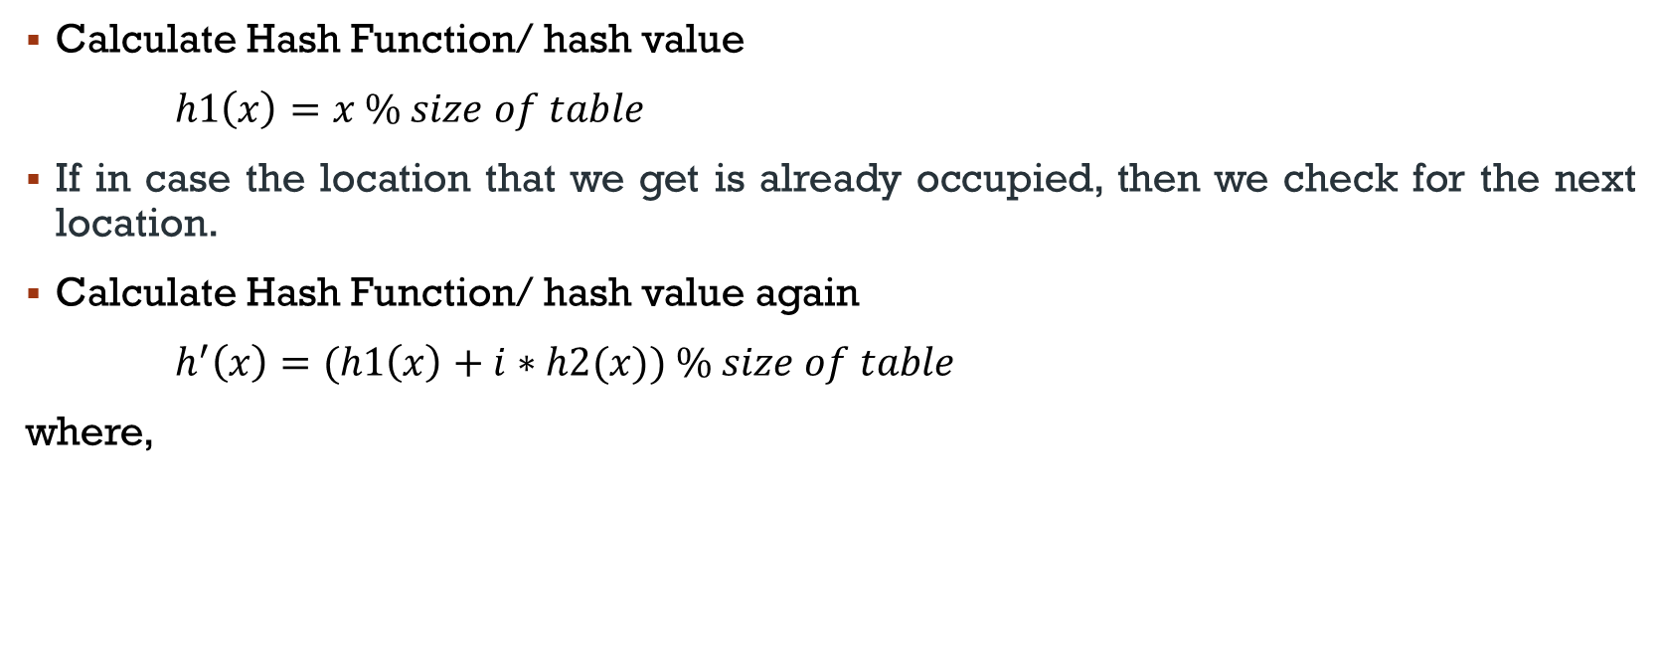
Double hashing
Calculate Hash Function/ hash value
$h1\left(x\right)=x \% size of table$
If in case the location that we get is already occupied, then we check for the next location.
Calculate Hash Function/ hash value again
$h^{′}\left(x\right)=(h1\left(x\right)+i∗h2(x)) \% size of table$
where,

Slide 30
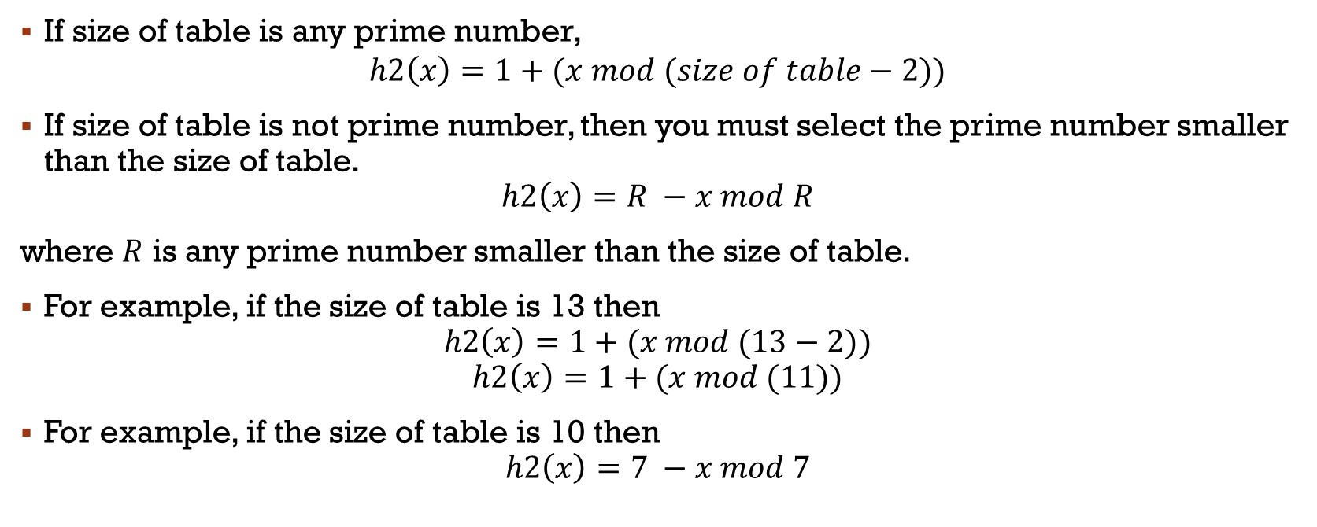
Double hashing
If size of table is any prime number,
$$h2\left(x\right)=1+(x mod (size of table−2))$$
If size of table is not prime number, then you must select the prime number smaller than the size of table.
$$h2\left(x\right)=R −x mod R$$
where $R$ is any prime number smaller than the size of table.
For example, if the size of table is 13 then
$$h2\left(x\right)=1+(x mod (13−2))$$
$$h2\left(x\right)=1+(x mod (11))$$
For example, if the size of table is 10 then
$$h2\left(x\right)=7 −x mod 7$$

Slide 31
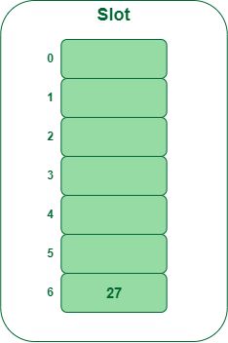
Double hashing
Insert the keys 27, 43, 692, 72 into the Hash Table of size 7.
First hash-function is h1​(x) = x mod 7
Second hash-function is h2(x) = 1 + (x mod 5)
Insert 27

Slide 32
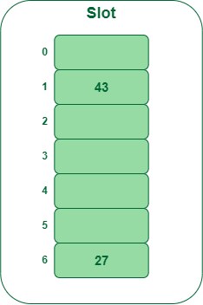
Double hashing
Insert 43 as the desired location is empty

Slide 33
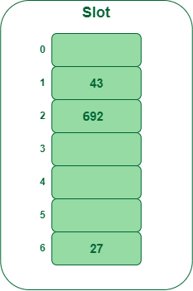
Double hashing
Insert 692
692 % 7 = 6, but location 6 is already being occupied and this is a collision
So we need to resolve this collision using double hashing.

Slide 34
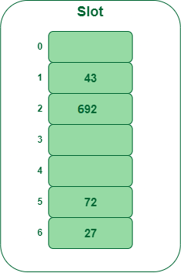
Double hashing
Insert 72
72 % 7 = 2, but location 2 is already being occupied and this is a collision
So we need to resolve this collision using double hashing.

Slide 35
Double Hashing
Advantages
Disadvantages
No extra space is wasted
No primary clustering
No secondary clustering
Double hashing is useful if an application requires a smaller hash table since it effectively finds a free slot.
It produces a uniform distribution of records throughout a hash table.
O(n) time complexity

Slide 36
Double Hashing: Example
Suppose there are six students in the Data Structures class and their IDs are 115, 153, 586, 206, 985, and 111, respectively. We want to store each student’s data in this order. Suppose HT is of the size 19.
How will the data is stored in HT using Double Hashing

